Slide 1

Arduino/C++ Workshop
ECU Robotics Society – Keegan Barnard, Jessica Dippenaar

Slide 2
Today’s Session - Thursday
9am- Introduction to LCD control, temperature and humidity sensor circuit with display
12-1pm - Lunch
1-3pm – Distance Sensor with Display

Slide 3
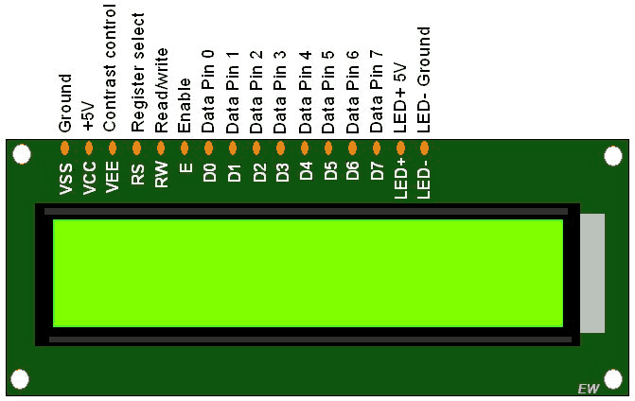
LCD
We don’t always want to rely on the serial monitor, so now we can start moving towards portable projects (creating our own systems rather than proof of concepts)

Slide 4
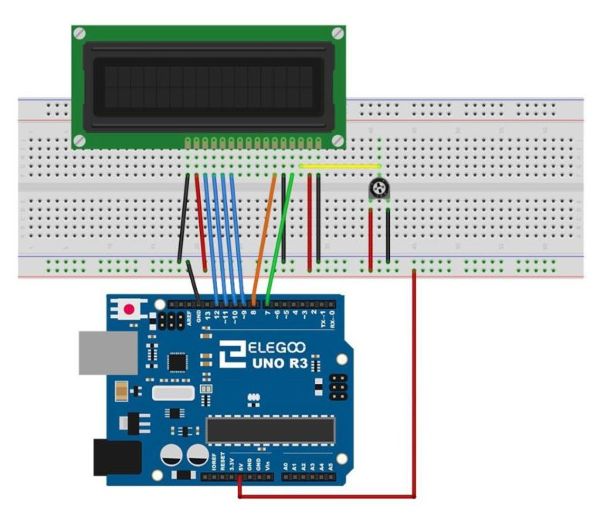
LCD and Potentiometer sensor

Slide 5
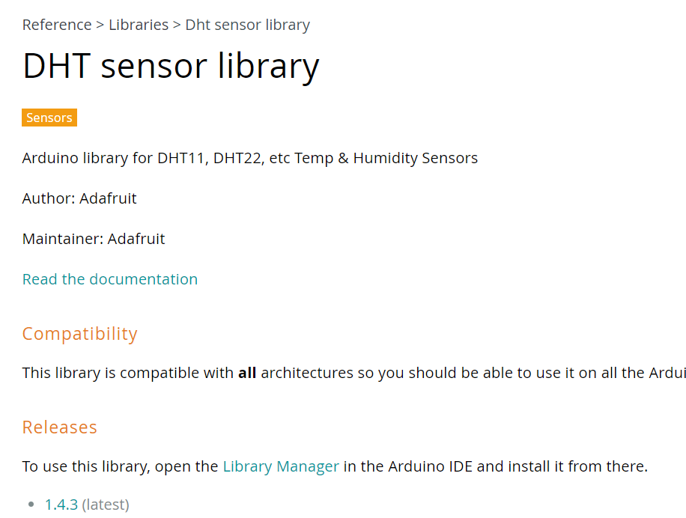
DHT11 Temperature and Humidity Sensor
Download DHT Sensory library
Drag and drop to desktop
Find “Sketchs” Location, example C:\Users\jessi\OneDrive\Documents\Arduino
Drag and drop library into the libraries folder: \Documents\Arduino\Libraries

Slide 6
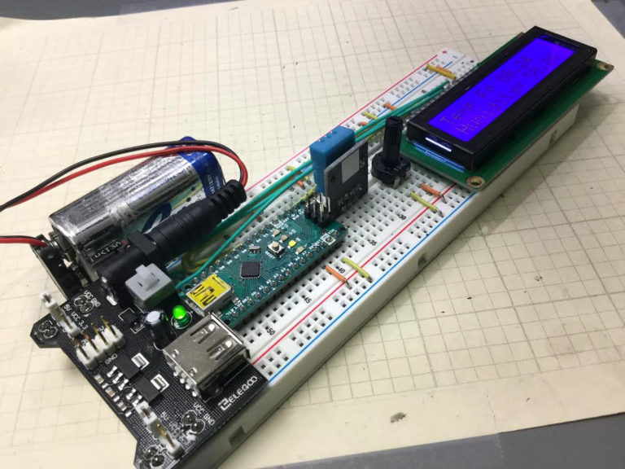
Task Overview – Portable Humidity and Temperature Display
LCD Display
Arduino Uno (Image shows Arduino Nano – works nicer when making prototype like work.
Power board
9V Battery
DHT Sensor
Potentiometer

Slide 7
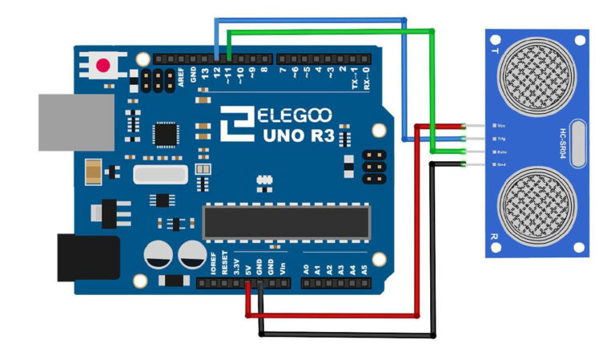
Ultrasonic Sensor – Measuring distance

Slide 8
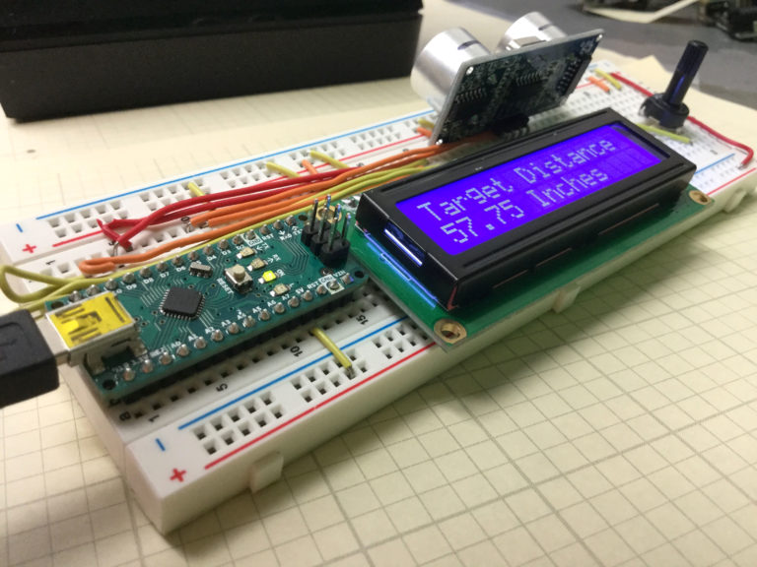
Task Overview – Portable distance sensor
Once we connect the LCD, instead of using pin 12 and 11, we will use pin 2 and 3
Connect the power board in the correct position (Same as previous

